Slide 1
Leads Scoring Case Study

Slide 2
Problem Statement
Help X Education identify the most promising leads, the leads that are most likely to convert into paying customers
Lead Conversion rate is 30%. X Education wants to increase this to 80%
Build a model to identify the attributes that impact lead conversion
Model should assign lead score to each lead such that the customers with a higher lead score have a higher conversion chance and the customers with a lower lead score have a lower conversion chance

Slide 3
Analysis Approach
Logistic Regression model is used to calculate the lead score
Steps include
Data Understanding - Read and analyse the data
Data Cleaning and Preparation
Data type alignment
Null value (including Select) treatment
Incorrect entries treatment
EDA
Model Building
Dummy Variables
Scaling using StandardScaler
Model building using Stats Model & RFE
Model Evaluation on Train and Test data set
Key Metrics calculation (Accuracy, Sensitivity, Specificity
ROC Curve
Optimal Cutoff point

Slide 4
Model Result Business
Model developed can help business to accurately predict the lead conversion with 92.5% accuracy
Top attributes impacting positively impacting lead conversion are Tags (Closed by Horizzon, Lost to EINS, Will revert after reading the email), Lead Source (Welingak Website), Specialization, Lead Origin (Lead Add Form) and Total Time Spent on Website
Top attributes negatively impacting lead conversion are Tags (switched off, Ringing, Already a student, Interested in other courses)
Sales team should be provided leads which have positively impacting attributes. Leads with negatively impact attributes should be filtered. This will improve conversion rate and productivity of the sales team
Few findings from EDA
Providing free copy of Mastering The Interview has no impact on lead conversion
Newspaper advertisement channel is not generating leads and can be stopped
Recommendations are one of the best source of leads with high conversion

Slide 5
Model Evaluation
Logistic Regression model can be deployed to help the business accurately predict outcomes (e.g., lead conversion) with 92.5% accuracy
The high precision and recall for both classes ensure that the model minimizes both false positives (incorrectly predicting a lead would convert) and false negatives (missing out on actual lead conversions)
A high ROC AUC score of 0.97 indicates the model can strongly differentiate between both classes, further enhancing its performance

Slide 6
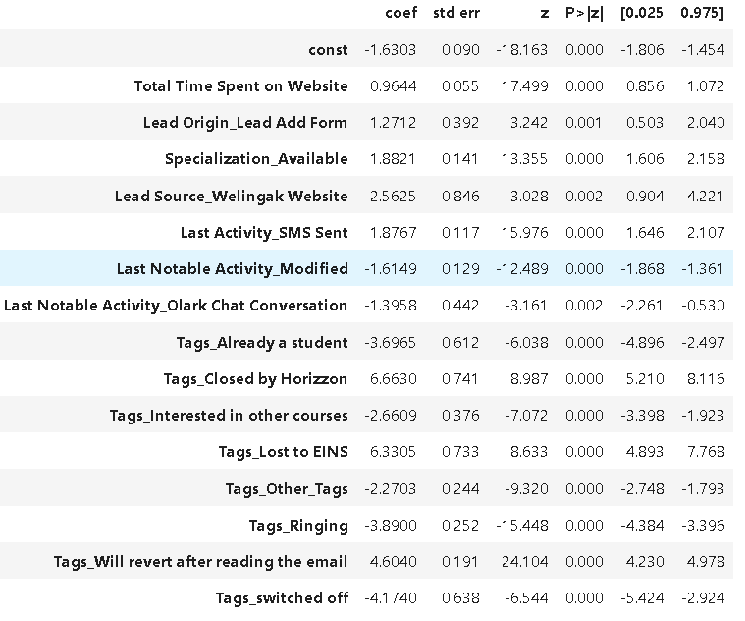
Model Result Final Attributes

Slide 7
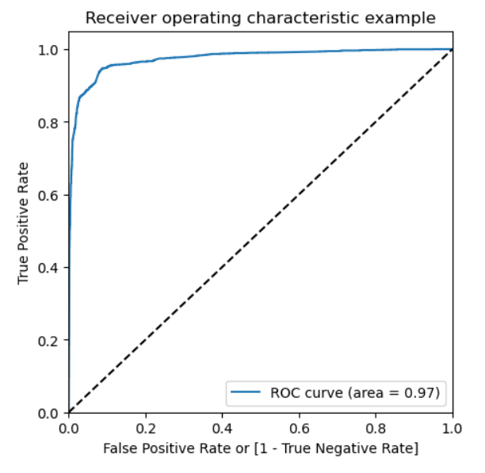
Model Evaluation Results
Metrics | Train Data | Test Data
Accuracy | 92.63% | 92.64%
Sensitivity | 94.13% | 93.28%
Specificity | 91.73% | 92.24%
Precision | 87.44% | 88.12%
Recall | 94.13% | 93.28%
ROC value of 0.97

Slide 8
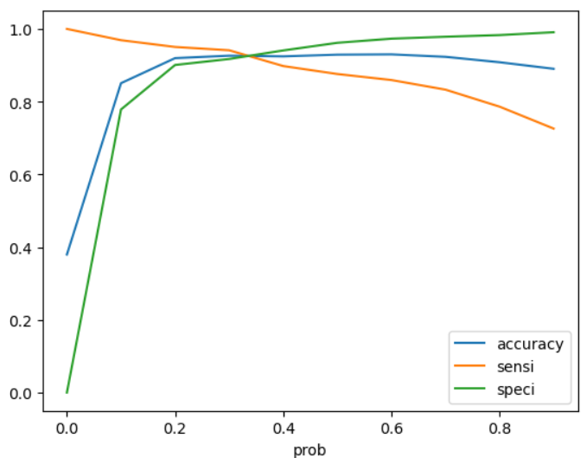
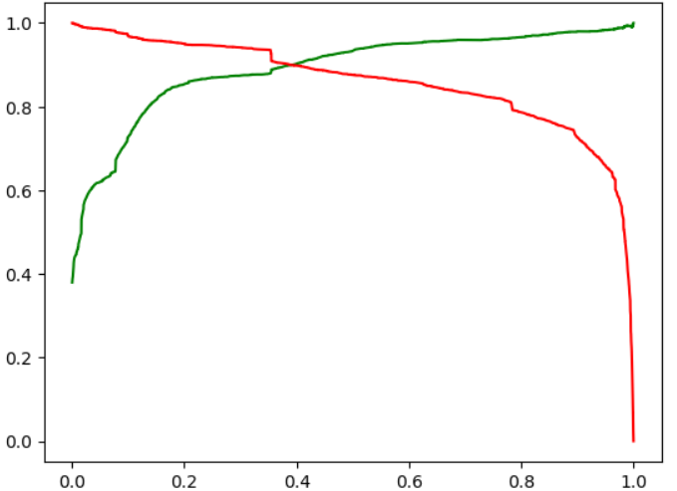
Model Evaluation
Optimal Cutoff Point 0.3
Precision Recall Curve

